Slide 1
Crime Records Analysis and Visualization System
Analyzing and Visualizing Crime Data Using Python and MySQL

Slide 2
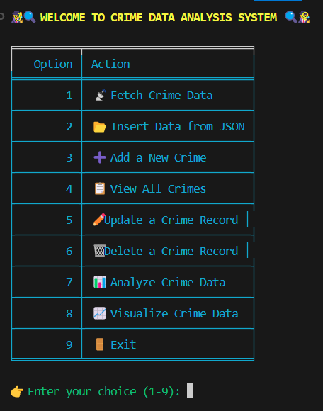
Introduction
This presentation delves into the methodologies employed in designing a system that efficiently fetches, stores, and analyzes real-time crime data using a blend of modern technologies.

Slide 3
01
Project Overview

Slide 4
Objective of the Project
The objective of this project is to develop a comprehensive, data-driven Crime Data Analysis System using Python, MySQL, NumPy, and Pandas. The system is designed to fetch real-time or historical crime data from open data sources such as data.police.uk, store it in a structured MySQL database, and process it using Python-based data analysis libraries.
The goal is to uncover crime trends, identify hotspots, and derive actionable insights through interactive visualizations. Additionally, the system supports complete CRUD operations—allowing users to add, view, update, and delete crime records—thereby facilitating effective management and understanding of crime patterns across different locations and timeframes.

Slide 5





Tools and Technologies Used
Programming Language
Python – Core language used for development
Libraries & Frameworks
Pandas – For data manipulation and analysis
NumPy – For numerical computations
Matplotlib & Seaborn – For data visualization
MySQL Connector – To connect Python with MySQL database
Data Formats
JSON – For structured crime data insertion
CSV – For visualization and reporting
Database
MySQL – To store and manage crime data

Slide 6
Project Workflow Overview
The project begins with the data collection phase, where crime-related information is fetched from public APIs such as [data.police.uk]. This data, available in JSON or CSV format, is then temporarily stored for preprocessing. In the next step, the data is inserted into a structured MySQL database, where it is organized into multiple relational tables such as crimes, locations, streets, and outcomes. Once the data is stored, the system supports CRUD operations — allowing users to add new crime records, view existing reports, update case statuses, or delete incorrect entries, ensuring clean and reliable data management.
Following data management, the project moves into the analysis phase, where powerful Python libraries like NumPy and Pandas are used to analyze the crime data. This helps uncover trends, hotspots, and patterns across time and locations. The insights are then transformed into meaningful visualizations using Matplotlib and Seaborn, helping users easily interpret the findings through interactive bar and line charts. Finally, the entire project is wrapped within a user-friendly, menu-driven terminal interface that features colorful formatting, emoji support, and table layouts, offering a smooth and engaging experience for end users.

Slide 7
02
Data Processing

Slide 8
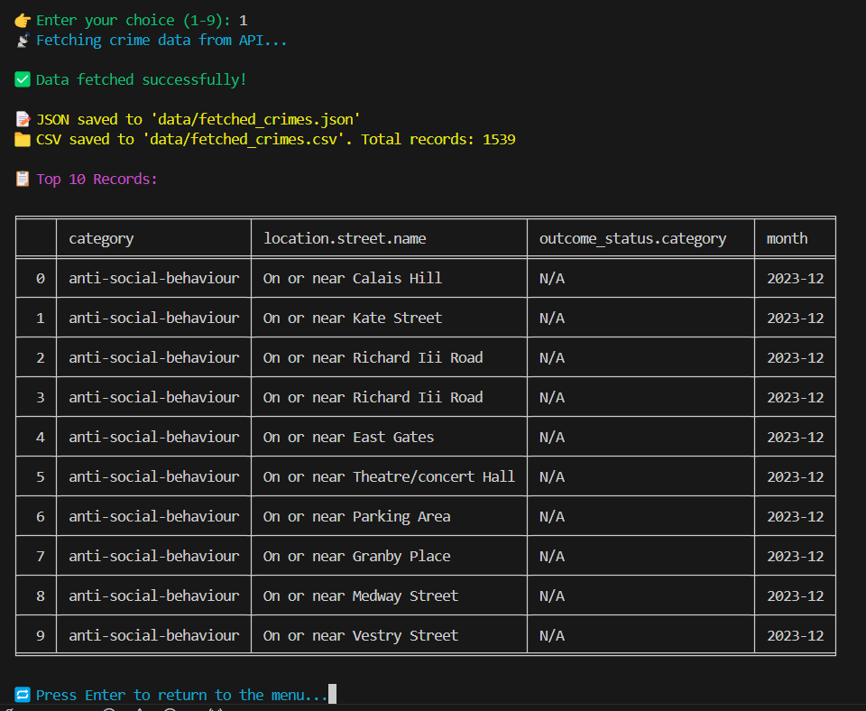
Fetching JSON Data
Data is retrieved using the requests library to make API calls to the UK Police dataset. Upon receiving the response, the data is stored in a local JSON file and CSV file for accessibility and backup purposes. This process ensures that accurate raw data is available for subsequent analysis. Each step is crucial, as it forms the foundation for the entire workflow.

Slide 9
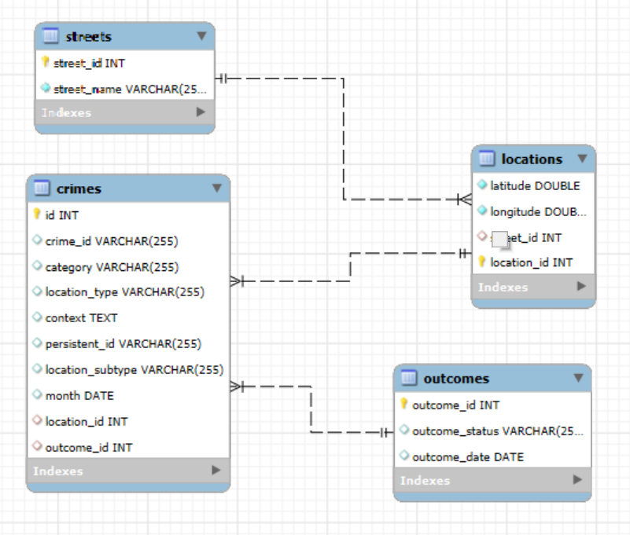
MySQL Database Structure
The MySQL database comprises several interlinked tables that facilitate efficient data management. Primary tables include 'locations', 'streets', 'outcomes', and 'crimes', which are structured to reflect the relationships between different data points. Foreign keys are employed to maintain integrity and facilitate complex queries, ensuring that users can efficiently retrieve and analyze related data sets.

Slide 10
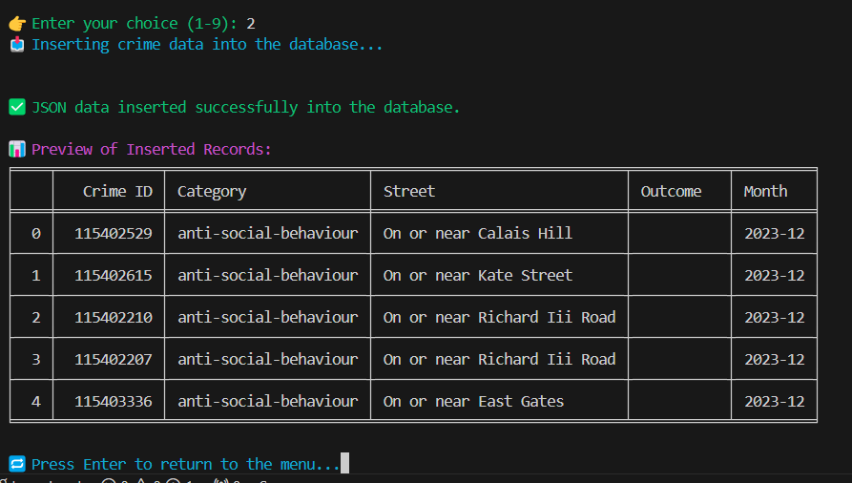
Inserting Data to MySQL
Data insertion into MySQL is conducted using the mysql.connector library in Python. Prior to this step, data is cleaned to eliminate duplicates, ensuring only unique entries are added to the database. This is achieved using the 'INSERT IGNORE' SQL command, which streamlines the import process while maintaining database integrity. The insertion process also involves linking foreign keys correctly, promoting a coherent structure within the database.

Slide 11
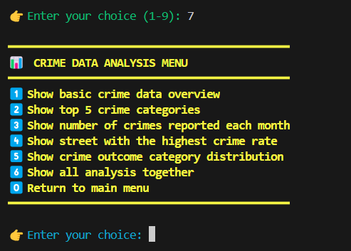
Analyse Crime Data
Crime data analysis helps identify patterns, trends, and relationships in criminal activity. By examining crime categories, trends over time, and geographical hotspots, law enforcement can allocate resources more effectively. Analyzing crime outcomes reveals the success rate of investigations, while location data aids in understanding crime-prone areas. Overall, this analysis provides valuable insights for improving crime prevention strategies and enhancing public safety.

Slide 12
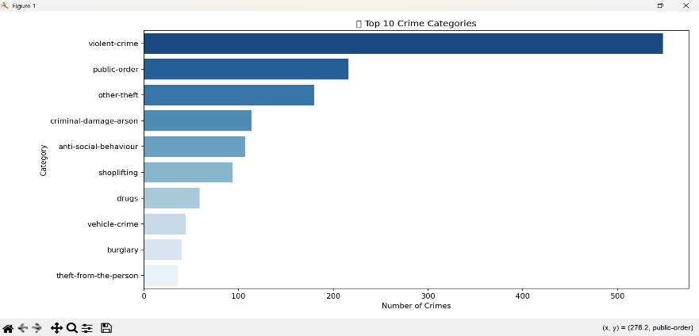
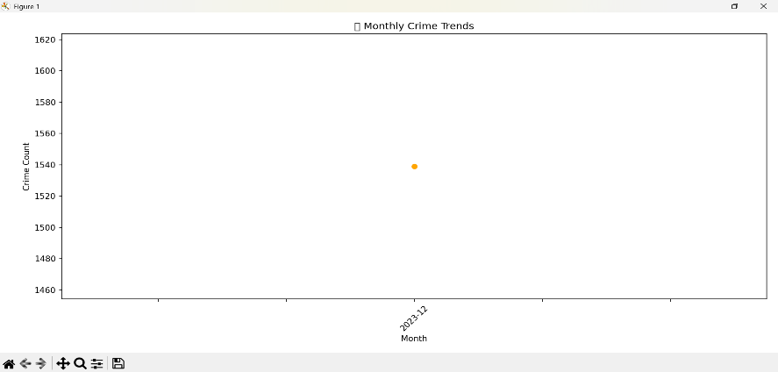
Visualize Crime Data
Crime data visualization helps in identifying trends, patterns, and areas of concern. By using various charts and graphs, such as bar charts, line graphs, pie charts, and heat maps, we can effectively showcase the distribution of crime categories, crime frequency over time, crime outcomes, and crime hotspots. These visualizations enable a clear understanding of the data, highlighting critical information such as the most frequent crime types, areas with high crime rates, and trends in crime occurrences. Such insights are essential for informed decision-making and targeted interventions in crime prevention.

Slide 13
Conclusions
The integration of the aforementioned technologies has resulted in a robust system for crime data analysis. By successfully fetching, storing, and visualizing real-time crime data, the project has built a scalable and reusable framework. This system not only enhances understanding of crime trends but also assists law enforcement and the public in making informed decisions regarding safety and resource allocation.

Slide 14
Thank you!
+91 620 421 838

